Slide 1
MODULE 4 – INTRODUCTION TO PERIPHERAL INTERFACING - I
Dr. P. Nirmala
Assistant Professor, Sr. Gr. I,
SENSE,
VIT Chennai Campus.

Slide 2
Programmable interrupt controller microprocessor - 8259

Slide 3
Why 8259
Consider that the CPU is connected with a number of I/O devices that would prefer to transfer data using interrupt driven data transfer mode.
In such cases, more number of interrupt pins are required than that are available in the microprocessor.
The processor will be subjected to take care of the priorities of the interrupts occurring at each pin.
To overcome these disadvantages, the programmable interrupt controller that is capable of handling number of interrupts is used.

Slide 4
continued
8259 can take care of all the interrupts simultaneously along with their priorities and types.
Intel’s 8259 was compatible with only 8-bit microprocessors but the advanced version of it, 8259A is compatible with 8 as well as 16-bit microprocessors.

Slide 5
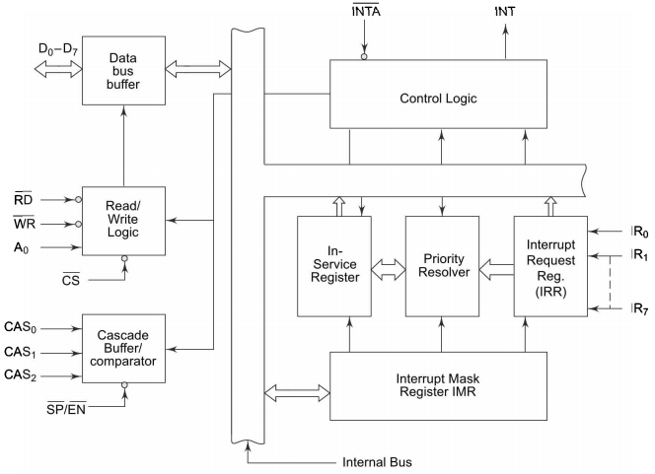
Architecture of 8259

Slide 6
Functional descriptions
Interrupt Request Register (IRR) – The interrupts at IRQ input lines are handled. Stores all the interrupt requests in order to address them one by one as per the priority.
Interrupt Service Register (ISR) – Keeps track of the requests being served
Priority resolver – Determines the priorities of the interrupt requests appearing simultaneously. Highest priority interrupt is selected and stored in the corresponding bit of ISR.
In fixed priority mode, IR0 has highest priority while IR7 has lowest priority.
Priorities can be altered by programming 8259 in rotating priority mode

Slide 7
continued
Interrupt mask register (IMR) – Stores the bits required to mask the interrupt inputs. It operates on IRR at the direction of priority resolver.
Interrupt control logic – Manages the interrupt and interrupt acknowledgement signals to be sent to the CPU. It also accepts INTA signals from the CPU.
Data Bus Buffer – Interfaces 8259A to the microprocessor system data bus. Control words, status, other information pass through data buffer during Read, Write operations

Slide 8
continued
Read/write control logic – Accepts and decodes commands from CPU. Allows status of 8259A to be transferred via the bus
Cascade buffer/comparator – Stores and compares the IDs of all the 8259As used in the system.
The three pins CAS0-2 are output pins when 8259 acts as master
The same pins are input pins when 8259 acts as slave.

Slide 9
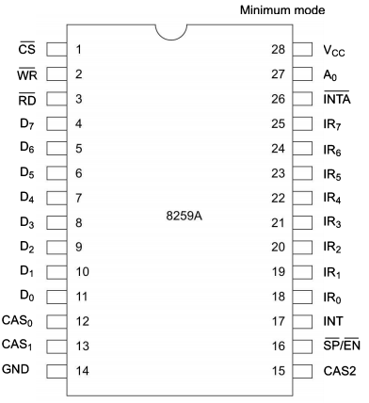
Pin diagram

Slide 10
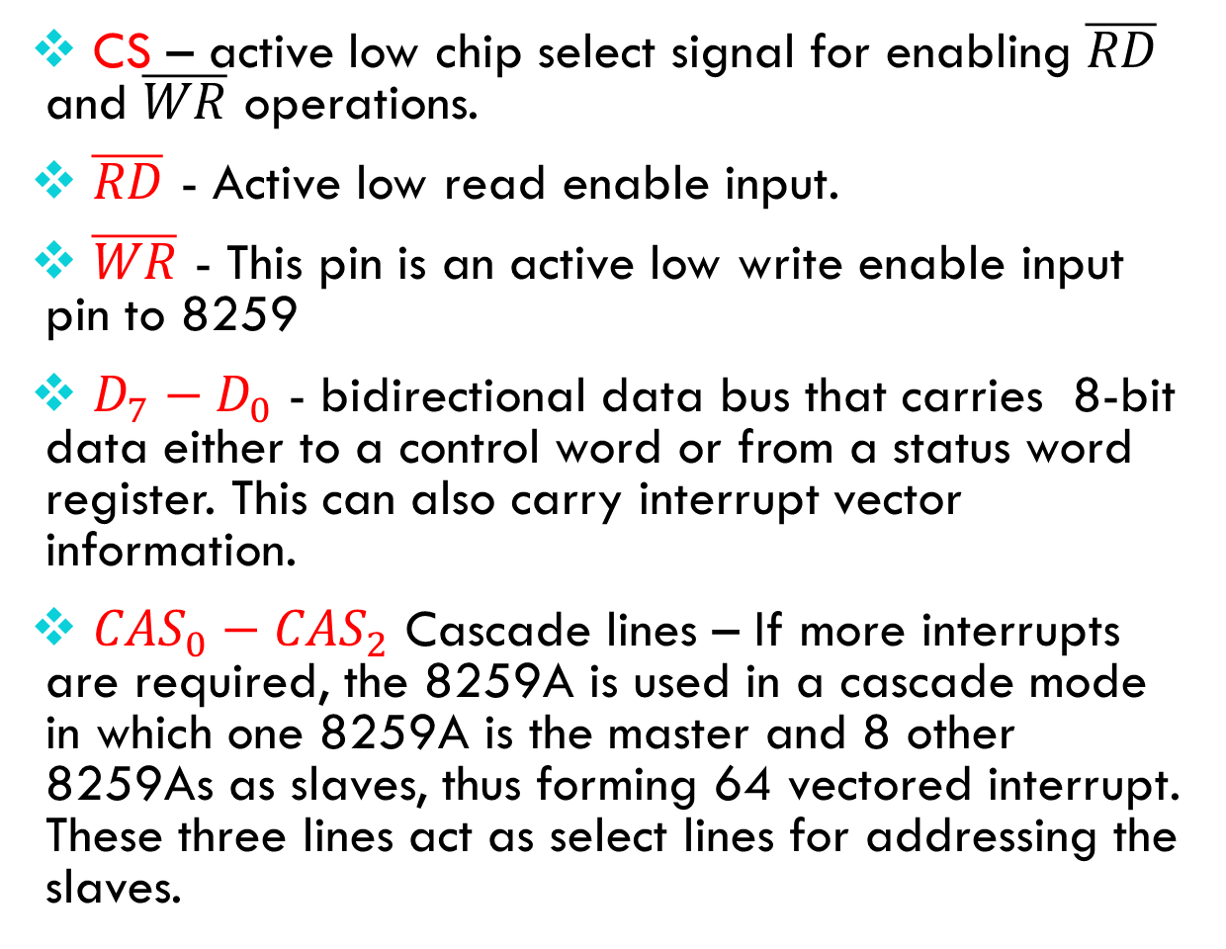
continued
CS – active low chip select signal for enabling $\overline{RD}$ and $\overline{WR}$ operations.
$\overline{RD}$ - Active low read enable input.
$\overline{WR}$ - This pin is an active low write enable input pin to 8259
$D_{7}−D_{0}$ - bidirectional data bus that carries 8-bit data either to a control word or from a status word register. This can also carry interrupt vector information.
${CAS}_{0}−{CAS}_{2}$ Cascade lines – If more interrupts are required, the 8259A is used in a cascade mode in which one 8259A is the master and 8 other 8259As as slaves, thus forming 64 vectored interrupt. These three lines act as select lines for addressing the slaves.

Slide 11
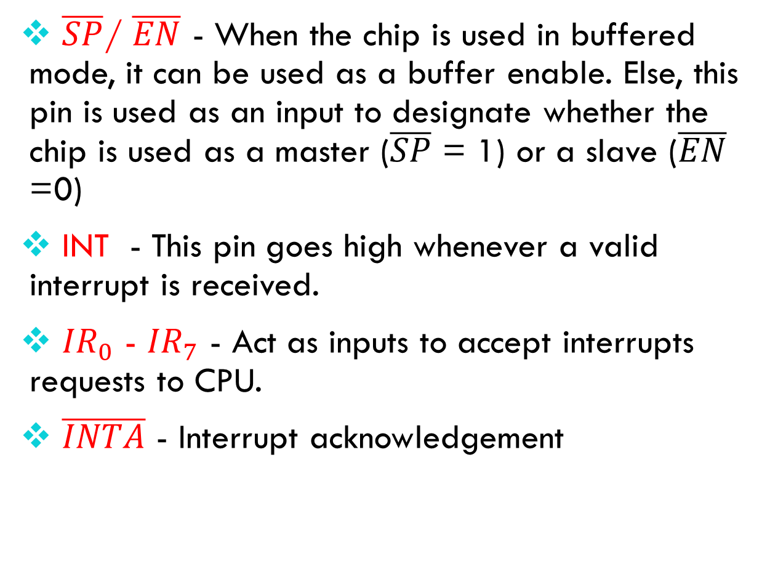
continued
$\overline{SP}$/ $\overline{EN}$ - When the chip is used in buffered mode, it can be used as a buffer enable. Else, this pin is used as an input to designate whether the chip is used as a master ($\overline{SP}$ = 1) or a slave ($\overline{EN}$ =0)
INT - This pin goes high whenever a valid interrupt is received.
${IR}_{0}$ - ${IR}_{7}$ - Act as inputs to accept interrupts requests to CPU.
$\overline{INTA}$ - Interrupt acknowledgement

Slide 12
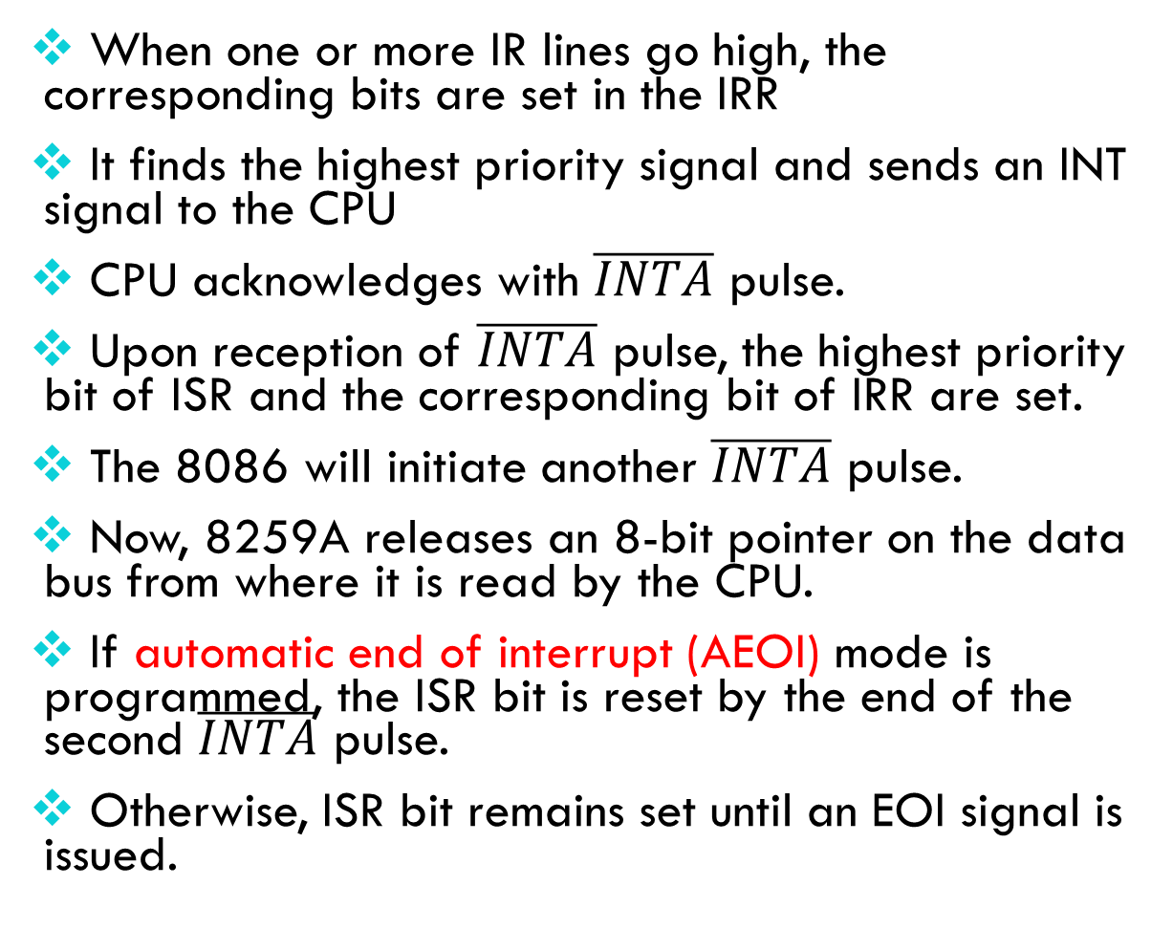
Interrupt sequence
When one or more IR lines go high, the corresponding bits are set in the IRR
It finds the highest priority signal and sends an INT signal to the CPU
CPU acknowledges with $\overline{INTA}$ pulse.
Upon reception of $\overline{INTA}$ pulse, the highest priority bit of ISR and the corresponding bit of IRR are set.
The 8086 will initiate another $\overline{INTA}$ pulse.
Now, 8259A releases an 8-bit pointer on the data bus from where it is read by the CPU.
If automatic end of interrupt (AEOI) mode is programmed, the ISR bit is reset by the end of the second $\overline{INTA}$ pulse.
Otherwise, ISR bit remains set until an EOI signal is issued.

Slide 13
Command words
Command words
Initialization CWs
Operation CWs

